Slide 1
Microsoft Movie Studio
Proposal
Presentation by: Mercy Ngila
Monday 23rd May

Slide 2
Understanding the problem
All the big companies are creating original video content microsoft wants to get in on the fun.
Microsoft is creating a new movie studio, but don’t know anything about creating movies.
😃

Slide 3
Objective
Explore what types of films are currently doing the best at the box office
Translate these findings into actionable insights that the head of Microsoft's new movie studio can use to help decide what type of films to create.

Slide 4
Project objective:
Understand other movie studios and their production
Advise strategies for Microsoft movie studio production

Slide 5
Dataset used
Data set used was acquired from:
Box Office Mojo
IMDB
Data:
Imdb.title.basics
Imdb.title.ratings
bom.movie_gross

Slide 6
Understanding the market

Slide 7
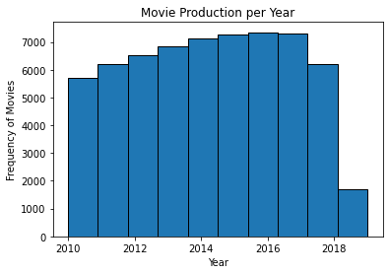
Movie production
Movie production has been on the increase over the years.
Now is a good time to get in on the fun.
Even with few months in, in 2018, production has really taken off.

Slide 8
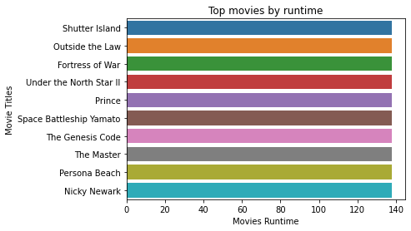
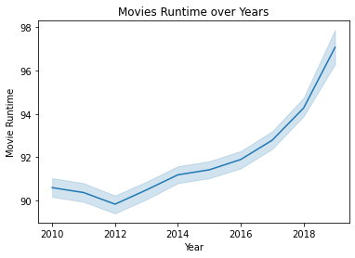
Runtime
Movie runtime has been increasing over the years.
The lengthiest movies currently stand at 138 minutes on average.

Slide 9
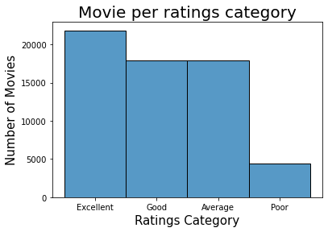
Ratings
Most of the movies are normally rated Excellent.
Ratings classified as:
Excellent (7 and above)
Good (6 and above)
Average (4 and above)
Poor ( below 4)

Slide 10
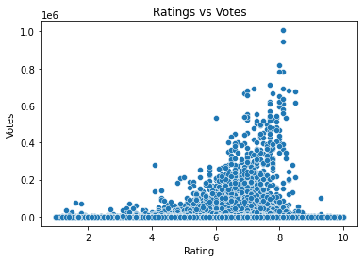
Votes
The higher the votes for a movie the higher the likelihood of great ratings

Slide 11
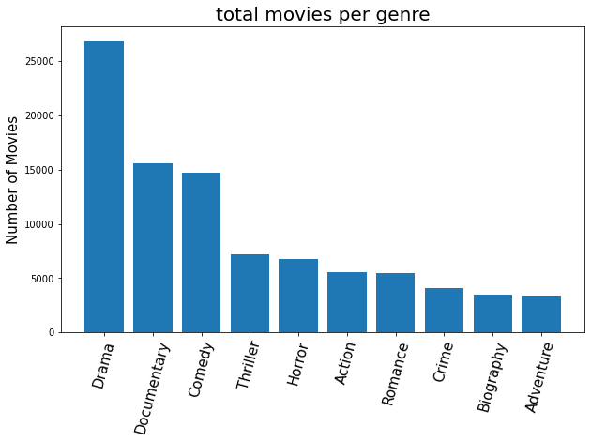
Genre
The highest genre in movie production is Drama movies.

Slide 12
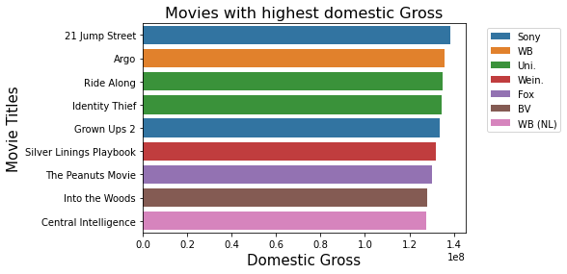
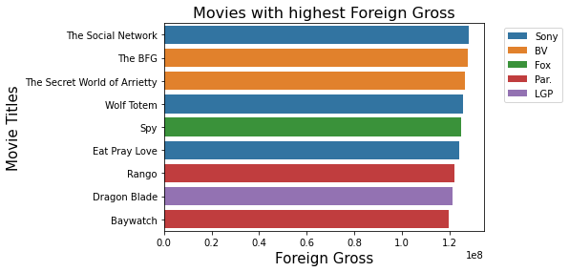
Revenue
Sony Studio managed to produce the top movie with the highest domestic and foreign revenue.

Slide 13
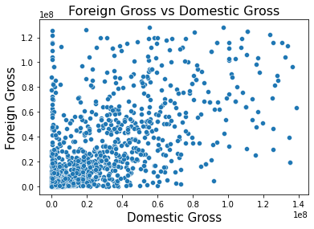
Revenue
A movie that will generate high domestic revenue may generate a high foreign revenue but it is not guaranteed.
A movie may generate high foreign revenue without necessarily generating high domestic revenue

Slide 14
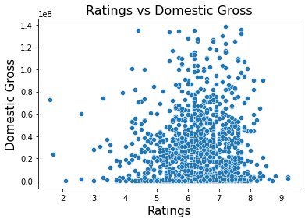
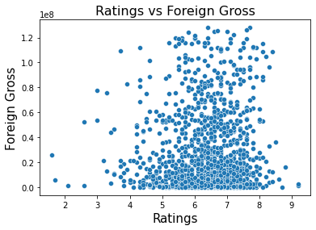
Revenue
Movie that generate high revenues have high chance of having high ratings

Slide 15
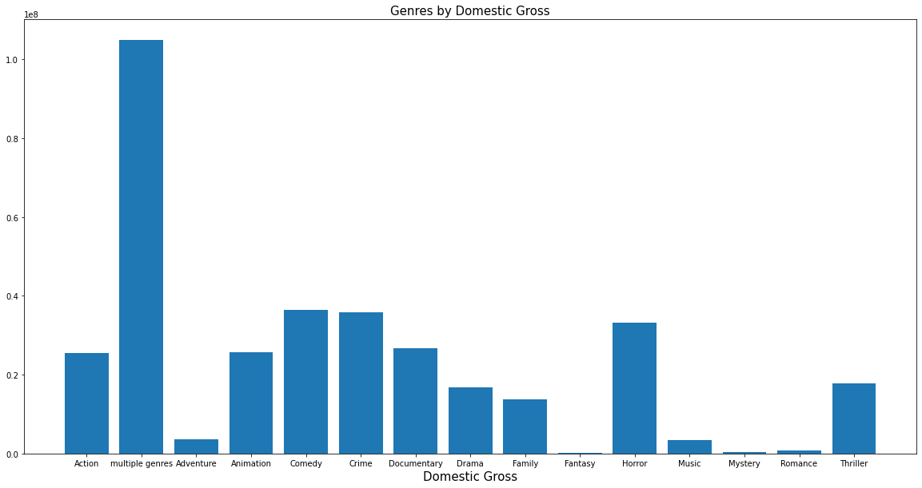
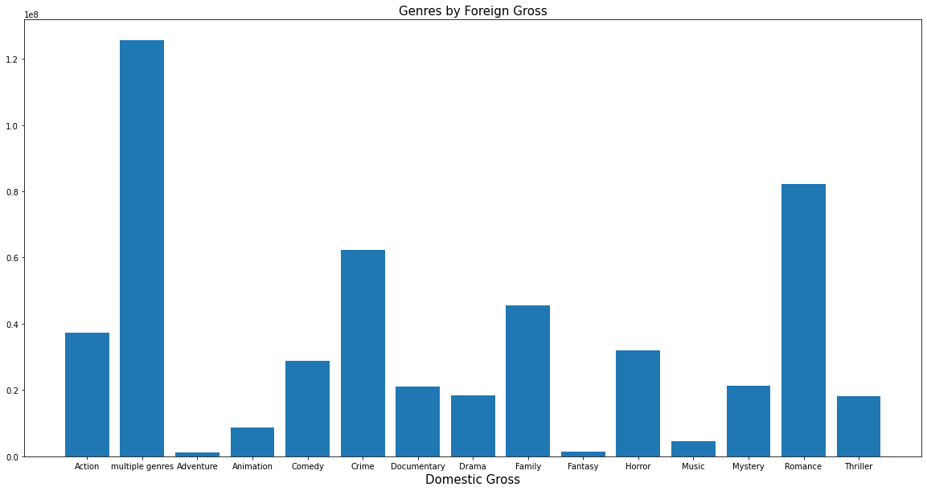
Revenue
Multiple genres
Movie that have multiple genres within it generate highest revenues both domestically and in the foreign market
Multiple genres

Slide 16
Recommendations
Recommendation 1
The lengthiest movie production should be at 138 minutes.
Recommendation 2
The best entry market movie should have multiple genres within it.
Drama genre is a safe bet for single genre or in a multiple genre movie
Recommendation 3
Different movies should be made for different markets (domestic and foreign)
Each market could generate high revenue but not necessarily both
Recommendation 4
Garnering more votes from viewers has a high possibility of generating a high rating

Slide 17
Conclusion
With the movie production increasing over the years now is the perfect time to hop in on the fun
Wendy Writer, CEO
Ronny Reader, CFO
Abby Author, CTO
Berry Books, CPO

